Slide 1
Checkpoint meeting ADS Thesis
Rick ten Eikelder

Slide 2
Progress Overview
Stage one (finished)
- (finished)Game of Life (GoL) simulation
- (finished) Random forest Classifier as representation of GoL
Stage two
- (finished) Forest fire model
- (finished) Random forest Classifier as representation
of Forest fire model
- (finished) Support Vector Machine model for quick comparison
- (current step) Expand to Snow-melt model (regression)
- (current step) Add regression
Stage three (next week)
- Add option to software for implementing drivers as training data

Slide 3
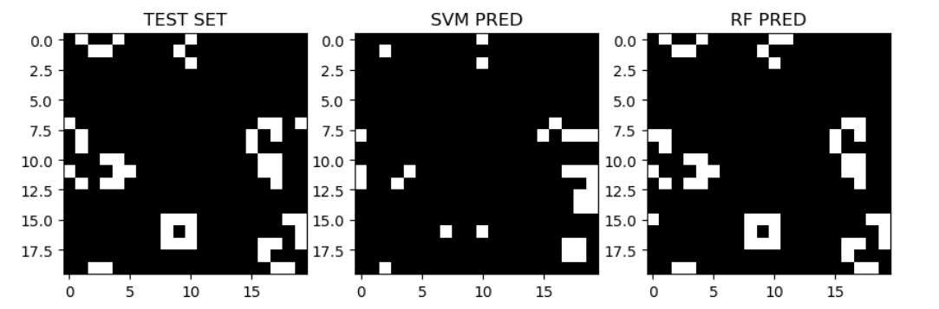
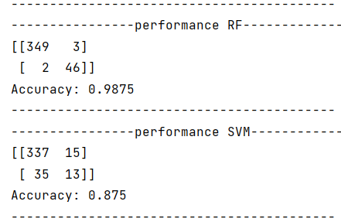
Game of Life results
!
Edges cause worse results for small simulations. →Data_prep.py
However: 4x / x^2 dependence
Where x is the size of the grid

Slide 4
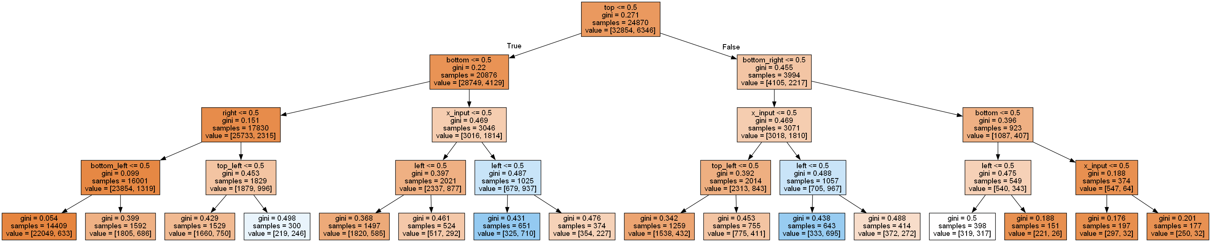
Part of One decision tree – Random forest based on many

Slide 5
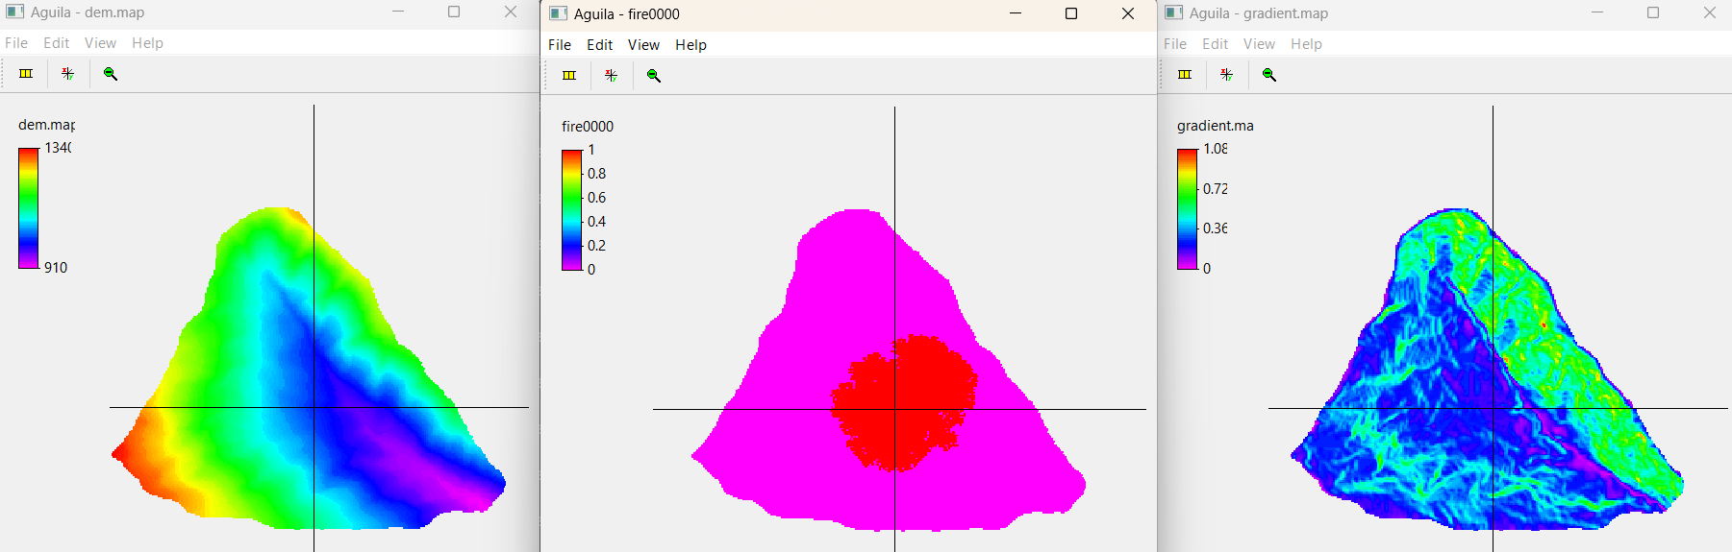
Predicted stage of forest fire

Slide 6
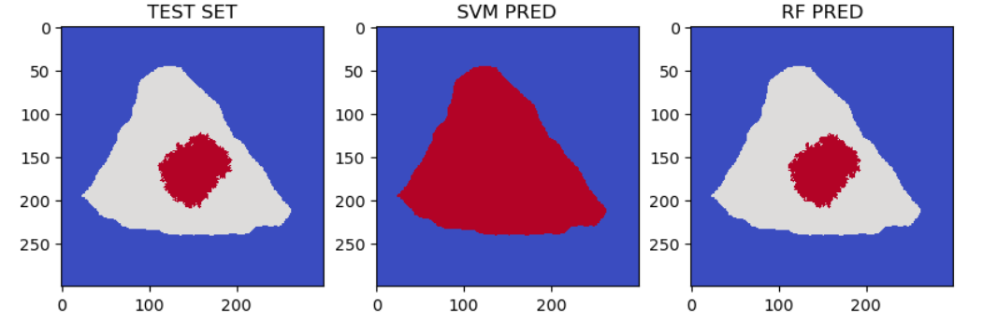
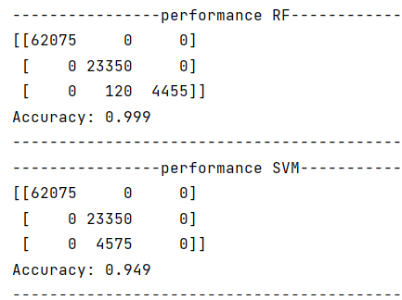
Forest fire result – neighbourhood only
Blue = NAN
Grey = OFF
Red = FIRE
!
Accuracy based on
NANS + FIRE/NoFIRE

Slide 7
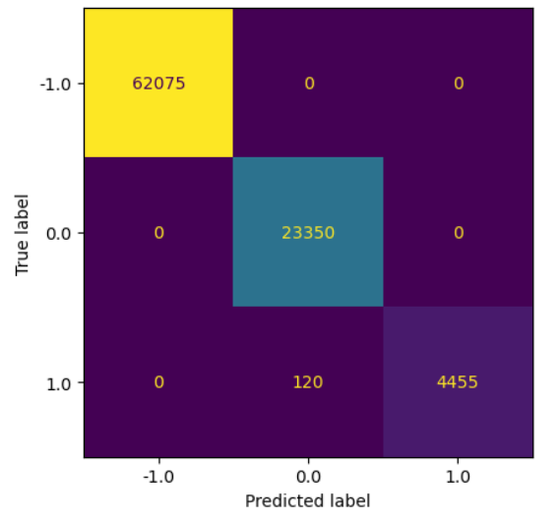
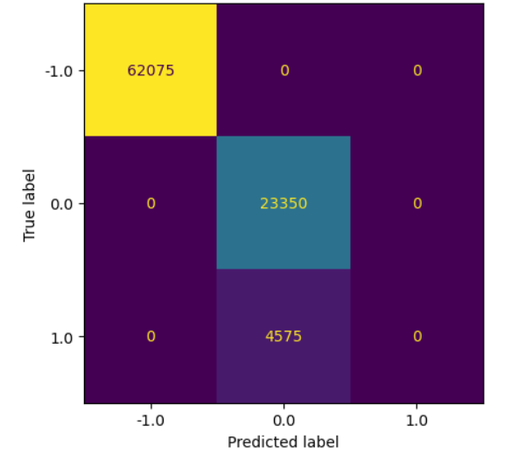
Forest fire result – neighbourhood only
! Awareness !
Accuracy based on
NANS + FIRE/NoFIRE
RF
SVM

Slide 8
Progress Overview
What’s next?
Start writing report (this week)
Stage 2 (this week)
- (current step) Expand to Snow-melt model (regression)
- (current step) Add regression
Stage 3 (next week)
- Add option to software for implementing drivers as training data

Slide 9
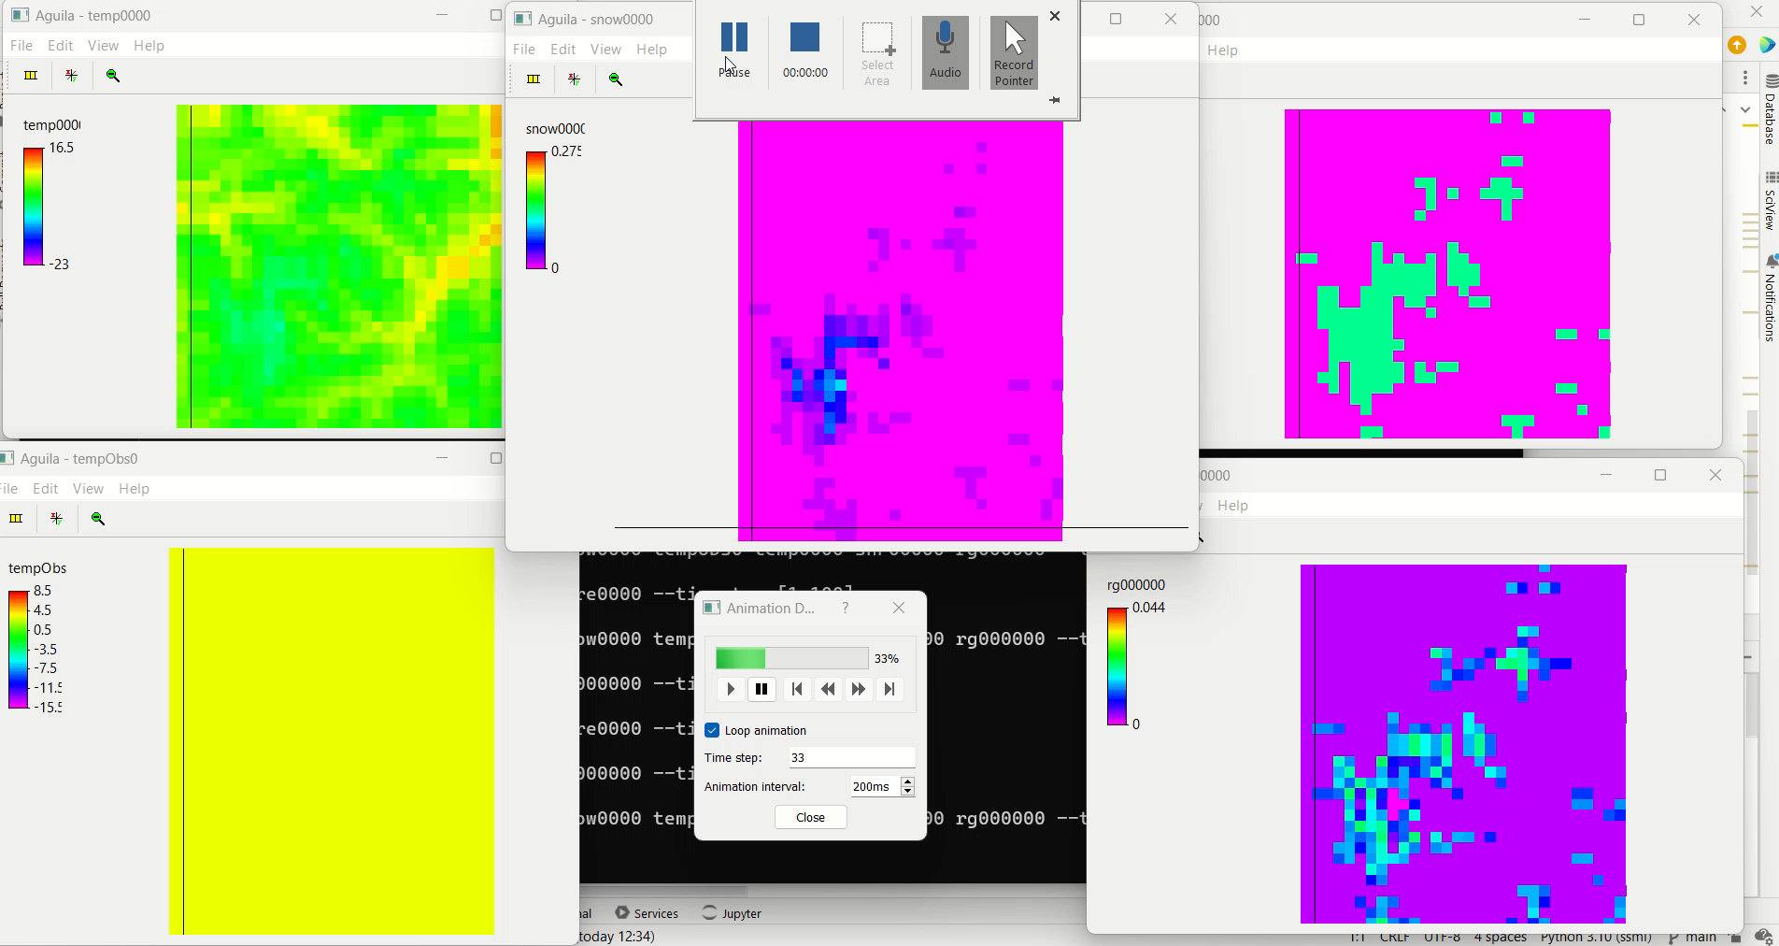
Next Step

